Slide 1
세상 모든 자연과 통하다
GLOBAL ECO THE SAEM
Gem Miracle Auto Pore Cleanser

Slide 2
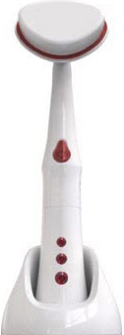
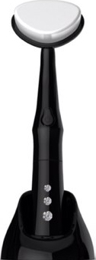
Profile of Gem Miracle Auto Pore Cleanser
Product Name | GEM MIRACLE Auto Pore Cleanser
Concept | Professional quality auto cleanser with upgraded brush and vibration quality in luxurious design. Easy to use! Smart and Outstanding result ! This smart auto cleansing tool deeply cleanses the impurities in the pores that the traditional hand cleansing can’t get off.
TARGET | Customers who wants DIY professional-quality care . Customers with enlarged pores or break out concerns. Aging skin Customers who prefer more luxurious modern design.
Price | Korean Retail Selling Price (KRSP) : ₩ 27,000 [ Replacement brush head : 8,000 won]
SKIN CARE BENEFIT
Deep Pore Cleansing
With 15,000 micro hair brush
Massage Effect
10,000 sonic vibrations/min
Professional-quality result with 8 benefits
Non-irritating, micro hair in triangular shaped brush --> triangular shape let you clean hard-to-reach corner like side of the nose.
166 vibrations / second,
10,000 / min sonic vibration not only deeply cleanse the skin but also stimulate the skin cells. Cleansing power is 6 times greater than the hand cleansing.
Clean pore
Excess oil control
Reduces blackheads
Cell stimulation
Smoother texture
Helps the absorption of other products.
Brightening
Lessens chance of breakout (Impurities elimination)
Other Features
Perfect pair with Gem Miracle Black pearl mask.. Introduce the Auto cleanser and GM Black Pearl mask TOGETHER. They work amazingly well together
Luxurious Design : Black or White body color with Swarovski Crystal.
Battery usage : lasts for 3 months (Based on 3 minute-use everyday)
Replacement brush head sold separately.

Slide 3
Other Tips
How To Use
1. Wet the skin and brush head.
2. Apply the foam cleanser directly on the brush.
3. Press the power button on the machine.
For the best result, move in the arrow direction with very little pressure.
* On nose area, pay more attention to get rid of blackheads.
4. Gently move the brush using a small circular motion. You do not need to press it hard against the skin.
5. Wash off with lukewarm water.
Cleansing Power
1. Orange Cleansing Test
BB cream on an orange
Hand Cleansing
Used an Auto Cleanser
2. Eye Makeup cleansing on hand
3. Direct Eye Makeup cleansing

Slide 4
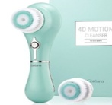
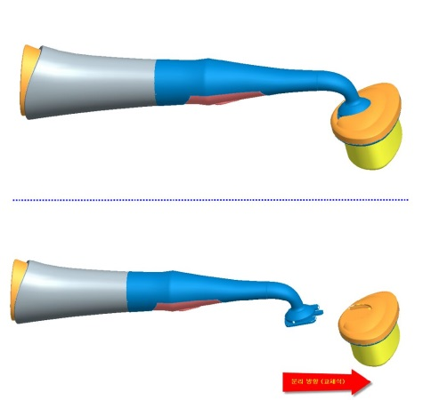
Other Tips
Comparison with other brand
 | THE SAEM | Missha | Others
Brush hair quantity | 150,000 hair | Unknown | 40,000 ~10,000 hair [Isa Nox: 80,000 hair, Koreana :97,000]
Sonic Vibration | 10,000 / min | Unknown | 6,000~9,000 / min
Design | Simple, practical, luxurious
Price | 27,000 won (Korean Retail Price) | 65,000 won (Korean Retail Price) | 50,000 ~90,000 (Korean Retail Price)
The Saem’s Pore Cleansing machine has superior quality and price competitiveness among all competitors.
How To change the head brush & Battery
Brush Head Replacement
Replacement period : If you use 2~3 times a week, you should change the brush after 6 months of use.
Battery Replacement
Hold the bottom body (where the buttons are) with left hand, hold the upper body with right hand , then turn counter-clockwise to separate them.
Hold the brush head with one hand and the body part with the other. Pull down the body part for separation.
How To keep the brush after use
Wash under running water until no the foam disappears.
Press the brush lightly to squeeze out the water.
Avoid direct sunlight. Store in a cool place.

